Slide 1




KBOR Blueprint for Literacy Study:
Advancing literacy excellence across Kansas
A comprehensive review of infrastructure readiness, educator needs, and statewide literacy insights
January 2026
prepared for the Kansas Board of Regents
by
Suzanne Myers
Jocelyn Washburn
Haiying Long

Slide 2
The Context: A Systemic Crisis Meets Policy Opportunity
The Challenge
State assessments reveal that only about 1/3 of Kansas students are reading at or above designated proficiency levels.
NAEP, locally administered benchmark assessments, and progress monitoring assessments also show some concerning trends for PreK-12 literacy in Kansas.
The Strategic Response
Kansas SB438 provides funding for KBOR to establish an Office of a Literacy, Literacy Advisory Council, and to carry out activities focused on improving literacy outcomes for PreK-12 students by implementing several targeted initiatives.
Kansas SB438
KBOR Office of Literacy initiated a contract with the Center for Research on Learning at The University of Kansas (KUCRL) to conduct research to inform the development, validation, and evaluation of tools and resources that would become part of the KBOR Literacy Institute and Institute of Higher Education Literacy Center services and resources.
Although Blueprint for Literacy funding was paused in 2025, research to inform the development, validation, and evaluation of tools and resources continues.
Last in Nation
Kansas ranking for professional learning spending per teacher

Slide 3
Key Initiatives
The KBOR Office of Literacy partnered with KU's Center for Research on Learning to conduct research and development in four areas.
1
2
3
4
Validation of a tool to assess school systems’ capacities to implement structured literacy
Validation of a pre-service educator literacy assessment
Statewide needs assessment through educator surveys, observations, and focus groups
Pilot of a Foundations of Science of Reading course

Slide 4
ASSESSMENT TOOL
VALIDATION AND PROCEDURE

Slide 5
Infrastructure Profiler Tool Validation
The Tool
The Process
The Participants
The Infrastructure Profiler Tool consists of the Infrastructure Readiness Survey and Infrastructure Profile.
The Infrastructure Readiness Survey measures school resources, personnel, and processes.
Infrastructure Readiness Survey output generates the school’s (or system’s) Infrastructure Profile.
6 Experts
3 with PhD or EdD
6 Elementary School Staff
4 teachers
1 principal
3 nationally renowned literacy consultants
3 curriculum or literacy coordinators
4 work outside Kansas
1 instructional coach
Expert Review
Cognitive Interview

Slide 6
Infrastructure Profiler Tool Validation
Key
Findings
Experts rated high the validity evidence based on scale contents.
Ratings across all questions M = 95.84
SD = 13.73
Experts suggested creating two surveys separately focusing on educators’ personal experience and administrators’ experience related to the school.
The scale may use more objective response options.
The scale may focus more on readiness and structured literacy.

Slide 7
Infrastructure Profiler Tool Validation: Recommendations
Create two surveys: one specifically tailored to teacher’s personal experiences of implementing a new practice or a PD at schools; the other survey for instructional coaches or school administrators about how they think their teachers’ readiness for implementing a new practice or a PD.
Focus on aspects that are objective as the response options. For instance, it may be easier for respondents to indicate how often they do something than to indicate whether something has a positive or negative influence.
Provide a clearer description of some terminologies in the questions. For instance, what does a professional learning community refer to?
Rethink some questions and their purposes to ensure they align with the readiness and structured literacy. Remove questions that may not be closely related to the readiness.
Activities Currently Underway:
Item review and revision in accordance with expert and field recommendations
Terminology clarifications within survey tool
Continuing broader expert and field review

Slide 8
Performance Assessment Validation
The Tool
The Process
The Participants
The performance assessment is a detailed structured literacy lesson plan completed by pre-service educators intended to be implemented in a general education setting during a 90-minute literacy block. A scoring rubric and example lesson plan are also provided.
Cognitive Interview
4 experts
All worked at different Kansas universities and used the performance assessment tool in their pre-service educator courses
3 faculty at different ranks
1 assistant educator at a teacher apprentice program
Expert Review
3 experts
1 professor at a Kansas university who has never used the performance tool in their classes
1 practitioner working at a Kansas school district
1 practitioner working as a national literacy consultant
Expert Review
Cognitive Interview

Slide 9
Performance Assessment Validation
Key
Findings
Performance assessment may not accurately reflect real classroom practices.
Performance assessment is especially challenging for pre-service preschool teachers to complete.
The 90-minute literacy block lesson plan may not be suitable for all classroom settings, particularly in lower elementary grades.
Lesson plan can be complemented by other performance assessment approaches such as video of teaching based on the lesson plan, exams that include real classroom scenarios, or a self-reflection on the thinking process of making the lesson plan.

Slide 10
Performance Assessment Validation: Recommendations
Include in the lesson plan a section that allows pre-service educators to demonstrate their performance in delivering the structured literacy lesson plan as a whole in real-world reading or writing contexts.
Ask pre-service educators to report characteristics of the classrooms they are teaching and provide clear goals for the lesson at the beginning of the lesson plan.
Include in the lesson plan explicit instructional expectations, require more details on assessments, incorporate multi-model instructional elements, and allow pre-service educators to articulate learning progressions.
Allow more flexibility about the length and contents of the lesson plan, enabling pre-service educators to decide the length and contents of the lesson they work on.
Complement the lesson plan, if any possible, by other ways of measuring pre-service educators’ performance in structured literacy, such as Praxis exam score, class observation, videos of teaching based on the lesson plan, or a self-reflection on the thinking process of making the lesson plan.
Activities Currently Underway:
Work with L7 team to validate newly revised performance assessment tool.
Revision of survey to collect pre-service educator feedback on new performance assessment tool.

Slide 11

STATEWIDE LITERACY INSTRUCTION AND RESOURCES NEEDS ASSESSMENT

Slide 12
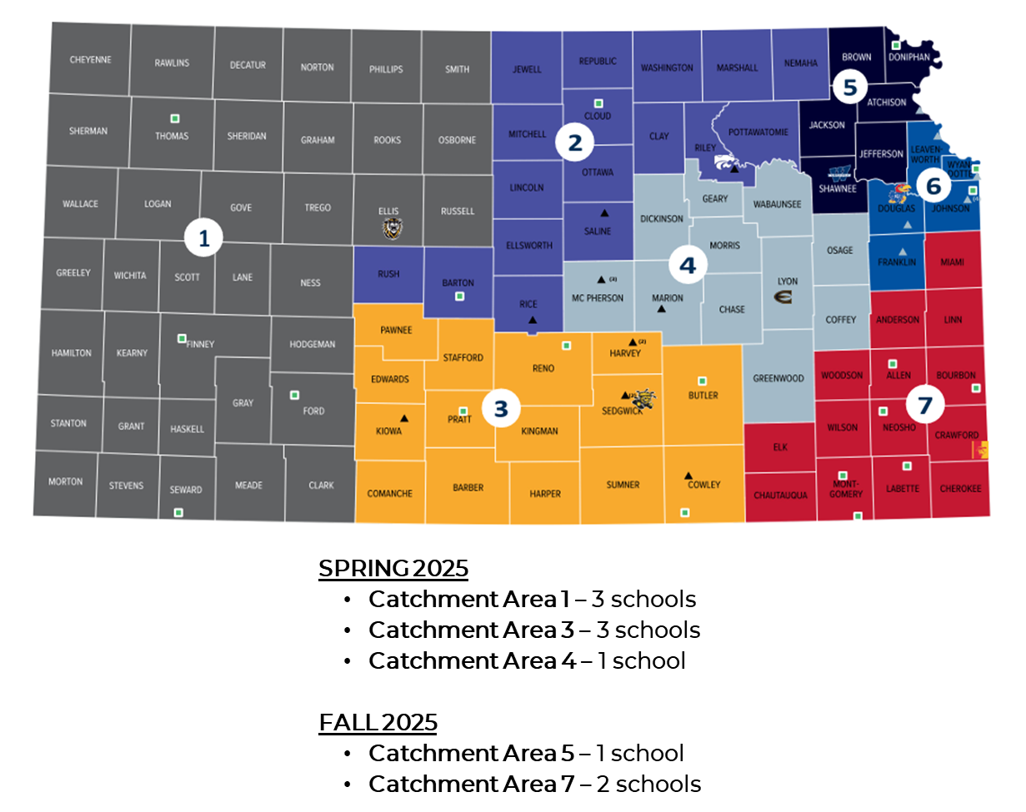
Statewide Needs Assessment
Methodology & Reach
Needs Assessment Components: Educator Survey Classroom Observations Focus Groups (Educators, Family, Students)
Site visits conducted: April, September, and October 2025 | Representative of 5 out of 7 KBOR Catchment Areas

Slide 13
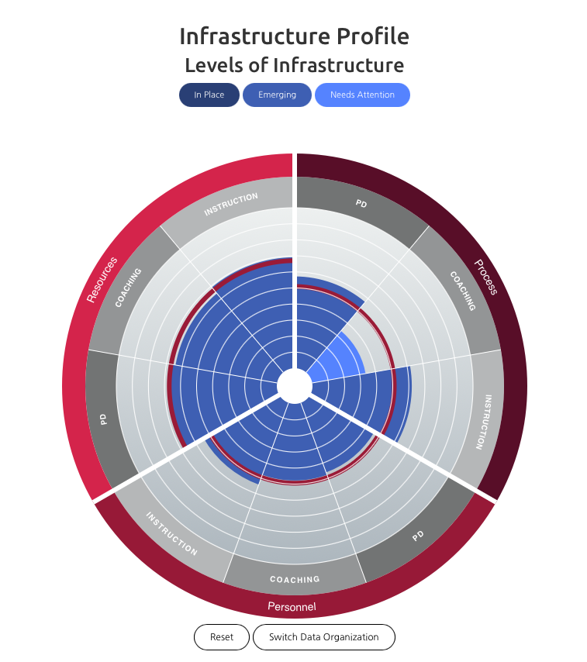
Needs Assessment: Educator Survey
Combined Infrastructure Profile of Schools Participating in the KS Literacy Needs Assessment
53 responses across
10 schools from
8 districts

Slide 14
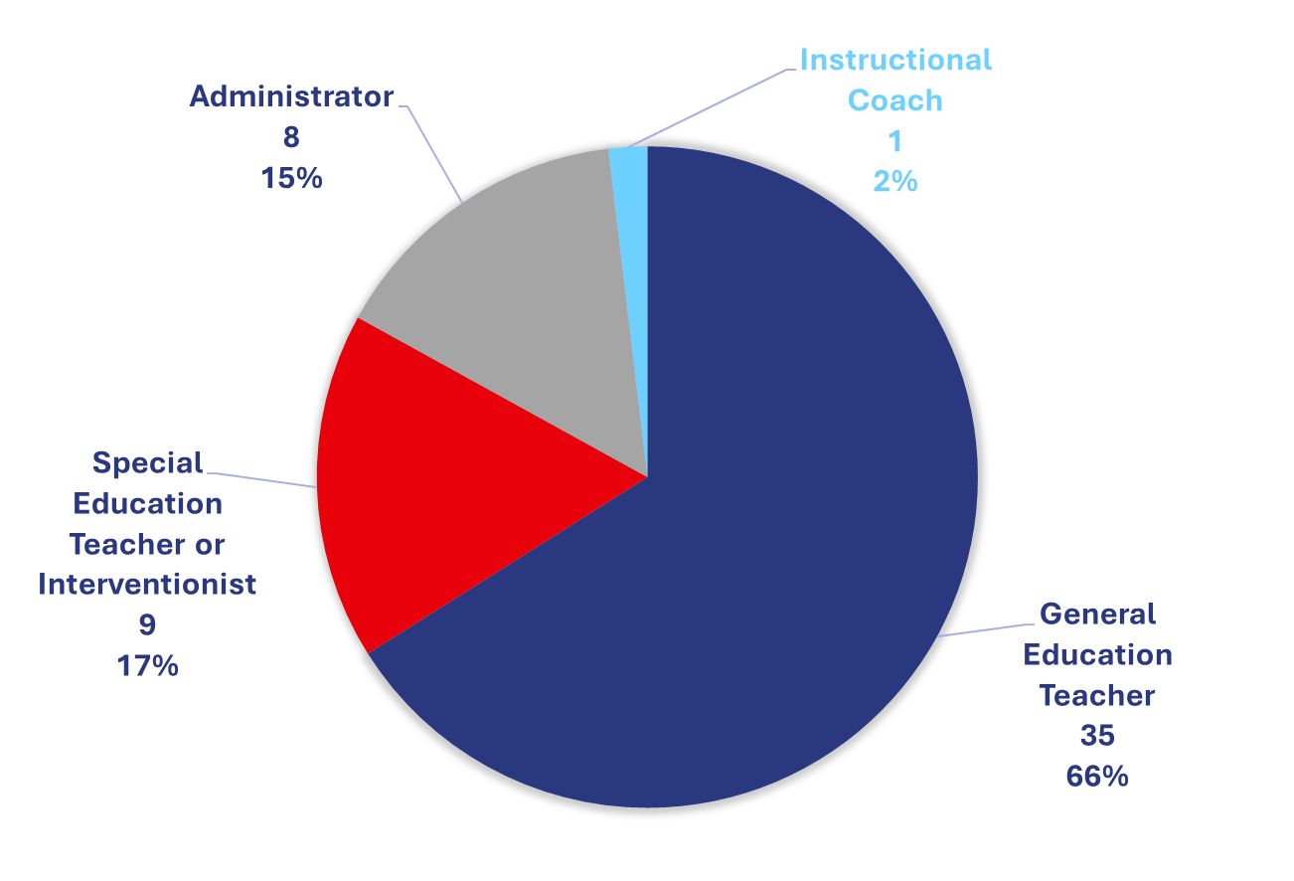
Current Role

Slide 16
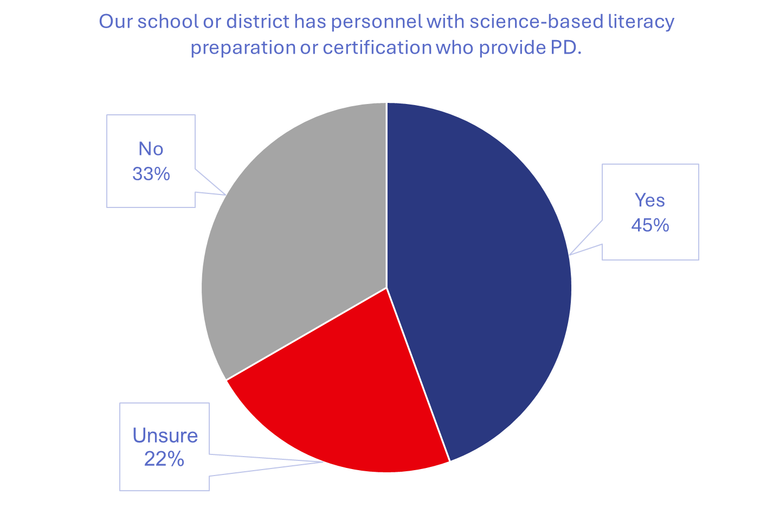

Slide 17
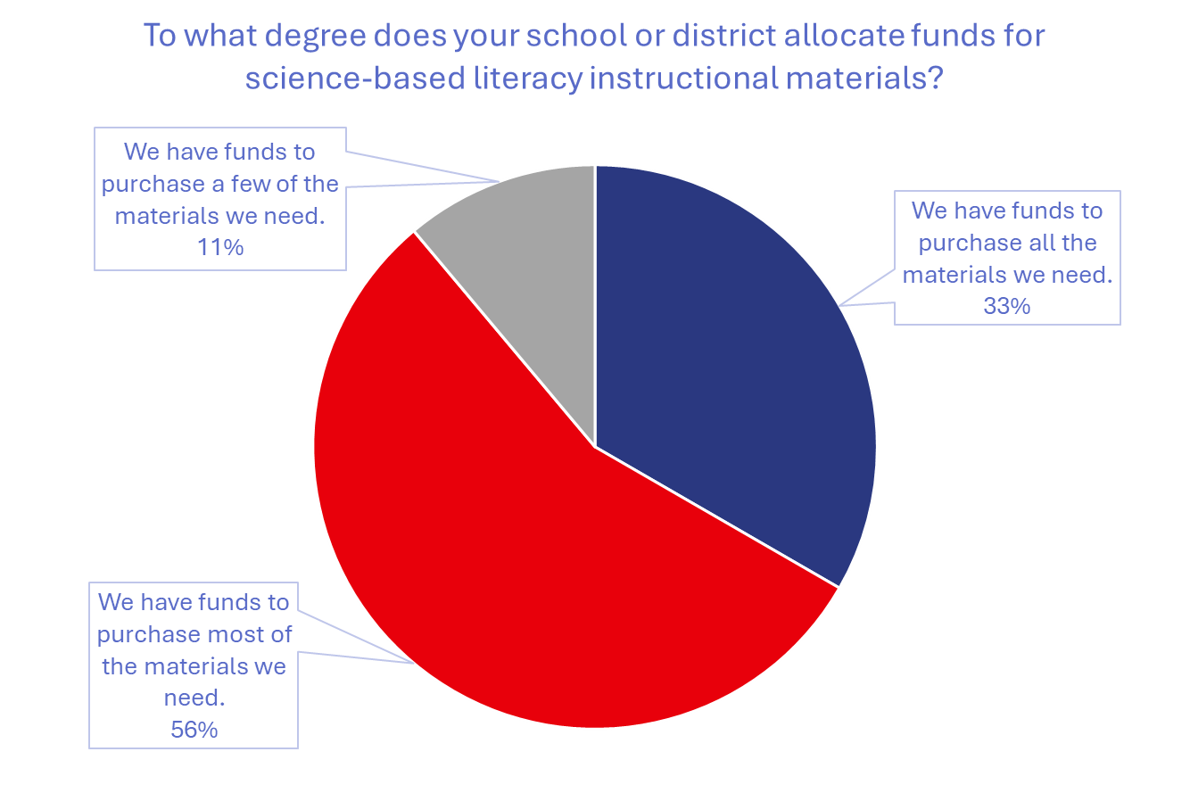

Slide 18
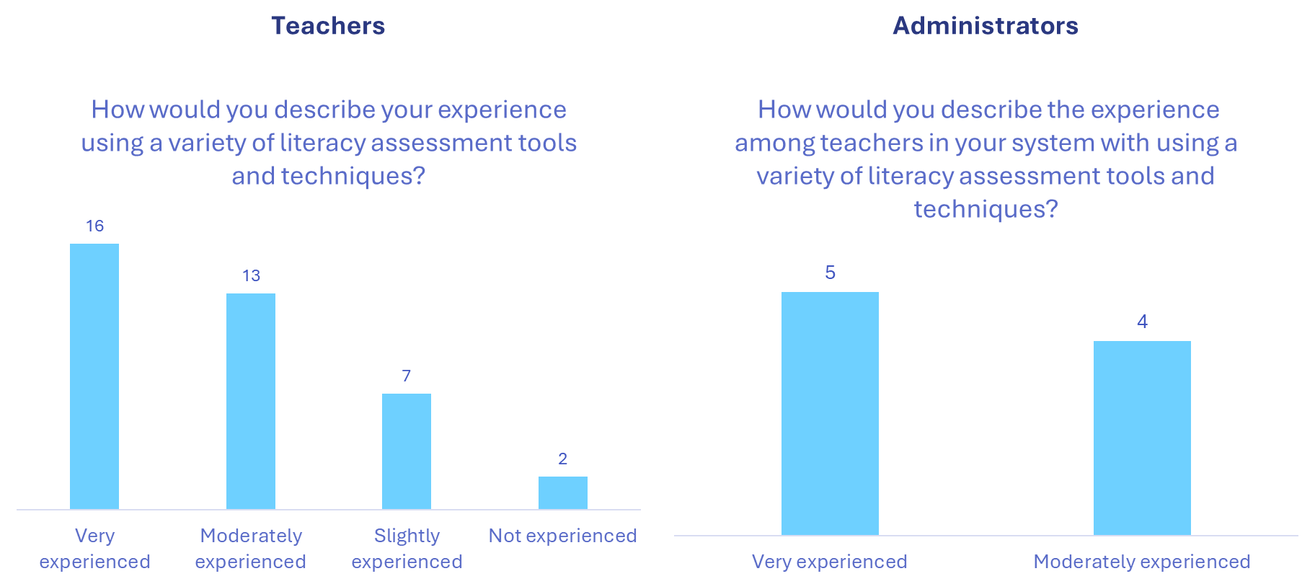

Slide 19
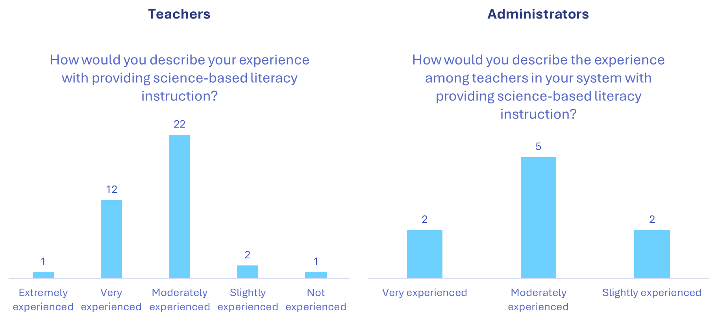

Slide 20
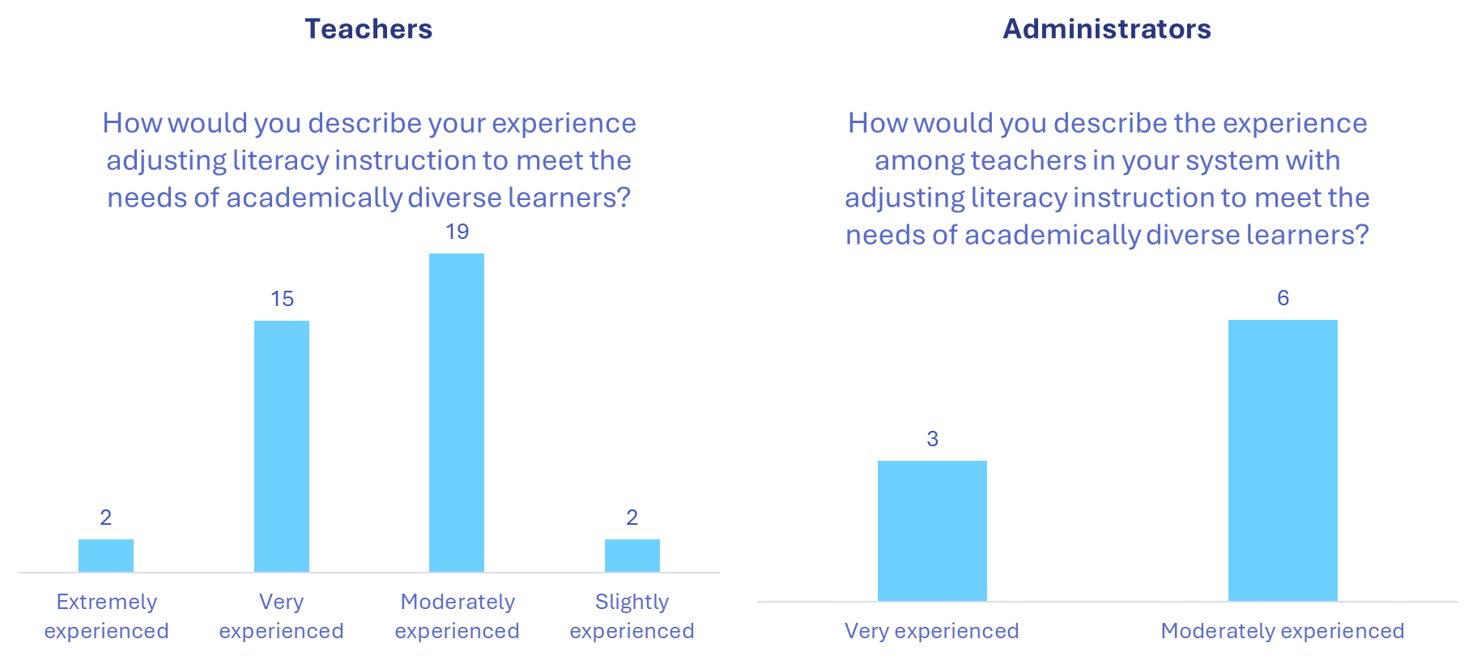

Slide 21
Needs Assessment: Classroom Observations
School Level | Number of Schools | Number of Classes | Number of Teachers | Number of Students
Elementary School | 7 | 51 | 31 | 574
Middle School | 2 | 15 | 7 | 244
High School | 1 | 6 | 2 | 44
Total | 10 | 72 | 40 | 862
Observation data from classroom visits indicated several trends in frequency of topics from Scarborough’s Reading Rope addressed during classroom instruction.
The top three literacy areas of focus across all classroom observations were phonics, phonemic awareness, and writing.
The bottom three areas of focus across all observations were word study, fluency, and discussion-based interactions.

Slide 22
Needs Assessment: Classroom Observations
School Level | Number of Schools | Number of Classes | Number of Teachers | Number of Students
Elementary School | 7 | 51 | 31 | 574
Middle School | 2 | 15 | 7 | 244
High School | 1 | 6 | 2 | 44
Total | 10 | 72 | 40 | 862

Slide 23
Needs Assessment: Classroom Observations

Slide 24
Needs Assessment: Focus Groups
22 focus groups at 9 schools
8 educator groups
6 parent groups
7 student groups
1 combined parent–student group
TOTAL PARTICIPANTS
(ACROSS ALL SCHOOL SITES)
51 educators
41 family members
49 students
Overlapping Themes
Across Three Groups
Importance of making good use of technology
Remaining cautious about its potential drawbacks
Continued emphasis on pen-and-paper writing, cursive practice, reading physical books, and engaging in real-world conversations
Valued family literacy activities
Call for hiring more educators and offering greater support to those who are currently teaching

Slide 25
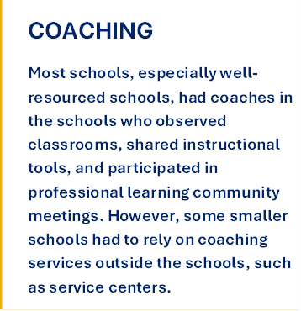
Key Findings From Educator Focus Groups
There is limited capacity for professional learning, due to lack of classroom coverage (substitute availability), poor organization, and poor planning of professional learning opportunities.
Teachers want more professional learning opportunities focused on supporting the practical application of their learning in professional development sessions.
Teachers want student materials to support summer reading programs.
Teachers have inequitable amounts of time for planning, ranging from zero minutes to multiple hours per day.

Slide 26
Key Findings From Family Member Focus Groups
Families desire earlier identification of their children’s literacy needs.
Families reported that school interventions did not fully meet the needs of their children with reading disabilities.
Families Identified a lack of interest in reading as a challenge for children without disabilities.
Families requested more support for grammar and vocabulary development.
Families emphasized the importance of children’s interest in reading and provided suggestions for improving reading interest.
Families expressed concern that teachers do not have enough resources.

Slide 27

Key Findings From Student Focus Groups
Students shared reading preferences and perspectives on reading and writing specifically.
Students mentioned specific games and apps as enjoyable ways to learn words.
Students discussed needing more support in reading and writing, such as one-on-one support, more teachers, and extra class time.

Slide 28
Needs Assessment: Recommendations
Educators may need to improve collaboration with professionals in inclusive classrooms.
Educators across all grade levels may need to increase their focus on vocabulary and word study instruction.
Educators should routinely use cognitive and metacognitive strategy instruction.
Schools need to add more robust implementation support for educators.
Systems need to provide support for principal literacy leadership and thoughtful planning.
Educators should differentiate instruction based on student performance data.
Recognize and differentiate support based on community-specific challenges.
Provide support for educators to address both instructional needs and student interests.
Activities Currently Underway:
Work with KBOR Office of Literacy to determine next steps for how we might address educator, family, and student support, in collaboration with other organizations and agencies.
Partner with Washburn Univ. to conduct study of Foundations courses’ impact on admin, educator, student learning, and instructional practices

Slide 29
PILOT STUDY FOR
FOUNDATIONS COURSES: Coaching

Slide 30
Foundations Pilot Study

Slide 31
Foundations Pilot Study
The Foundations Pilot required educators to engage in learning in three major ways:
12 Online modules delivered through the D2L Learning Management System
Synchronous sessions led by instructor Dr. Carolyn Carlson
One-on-One Virtual Literacy Coaching

Slide 32
Foundations Pilot Study
Coach Name | Coach ID | # Educators Assigned | Sessions Planned | Sessions Completed
RT | 1 | 6 | 64 | 57
GL | 2 | 4 | 32 | 31
MH | 3 | 4 | 43 | 37
LW | 4 | 4 | 39 | 34
HBW | 5 | 5 | 57 | 47
MG | 6 | 5 | 54 | 53
IC | 7 | 8 | 91 | 91
Total | 7 | 36 | 380 | 350
7 Pilot Foundations Course coaches facilitated 350 coaching sessions for a total of 8,533 minutes focused primarily on assessment, phonics, spelling, and vocabulary instruction.

Slide 33
Foundations Pilot Study

Slide 34
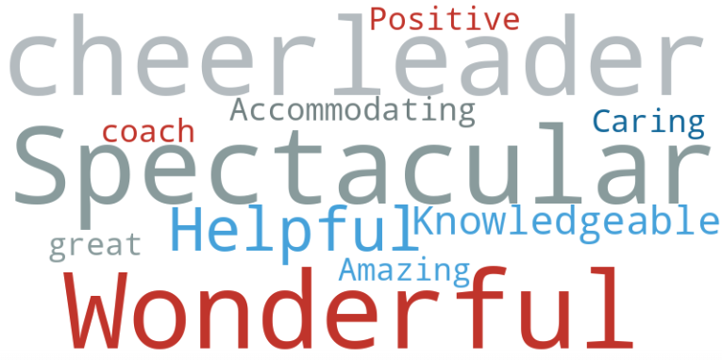
What Teachers Say About Their Coach
"I know my coach cares about me. She blew up my email when I missed a zoom call (forgot to put it in my calendar). She was worried something happened to me. Her messages reminded me of a worried mom. This made me feel like I wasn’t something on her to do list for the week. It showed she truly cares."
"My coach is very knowledgeable and accommodating. We have set goals and with her support I believe I can get them done during this busy time."
"I appreciate how my coach can tailor her support to my position outside the classroom."
"Meeting with my coach is the highlight of my week."
"I feel like my coach and I were made for each other."

Slide 35
Foundations Pilot Study: Recommendations
Findings should be shared with Foundations Pilot Coaches and Foundations Coaches throughout the state.
Teachers should have regular access to guidance and support for analyzing and using data to inform their literacy instruction.
The Foundations Course and coaching should provide comprehensive and interconnected literacy instruction.
Foundations courses are best implemented with experienced educators participating during a regular school term.
Activities Currently Underway:
Work with KBOR Office of Literacy to determine whether and how recommendations should be addressed.

Slide 36
FUTURE DIRECTIONS

Slide 37
Next Steps
Produce and disseminate publications of year 1 findings to support future funding and programming requests by the KBOR Office of Literacy, and to inform literacy support services provided by Regent universities, school districts, and other organizations with literacy initiatives.
Work with the L7 team of higher education literacy experts to inform changes to the lesson plan/performance assessment.
Continue gathering, analyzing, and ultimately disseminate evidence of validity and reliability for the Structured Literacy Infrastructure Readiness Tool to advance the science of reading in schools and districts.
Continue gathering, analyzing, and ultimately disseminate evidence of validity and reliability for the structured literacy performance assessment for pre-service educators.
In partnership with the KBOR Office of Literacy, create publications focused on how to meet the specific and varied needs of schools that differ by geographic region, type, size, and socioeconomic status.
In partnership with the KBOR Office of Literacy, disseminate and provide professional learning for use of validated tools to support implementation of structured literacy in PreK-16 systems.

Slide 38
For Your Consideration: Additional Areas of Study
A study of the revised lesson plan/performance assessment in partnership with undergraduate students and their instructors, to include a survey about the assessment administered to undergraduate students.
Additional studies of coaching models used in Foundations courses across the state.
Research and development work focused on adolescent literacy.
Cost effectiveness analysis of Foundations coaching, or broader literacy coaching, including analysis of coaching sessions required to meet an instructional goal and/or to improve student learning.
Studies of coaching work to support building administrators with supporting evidence-based literacy practices.

Slide 39
Thank you.
Suzanne Myers, Ed.D. suzannemyers@ku.edu
Jocelyn Washburn, Ph.D. jwashburn@ku.edu
Haiying Long, Ph.D. hlong@ku.edu

